Slide 1
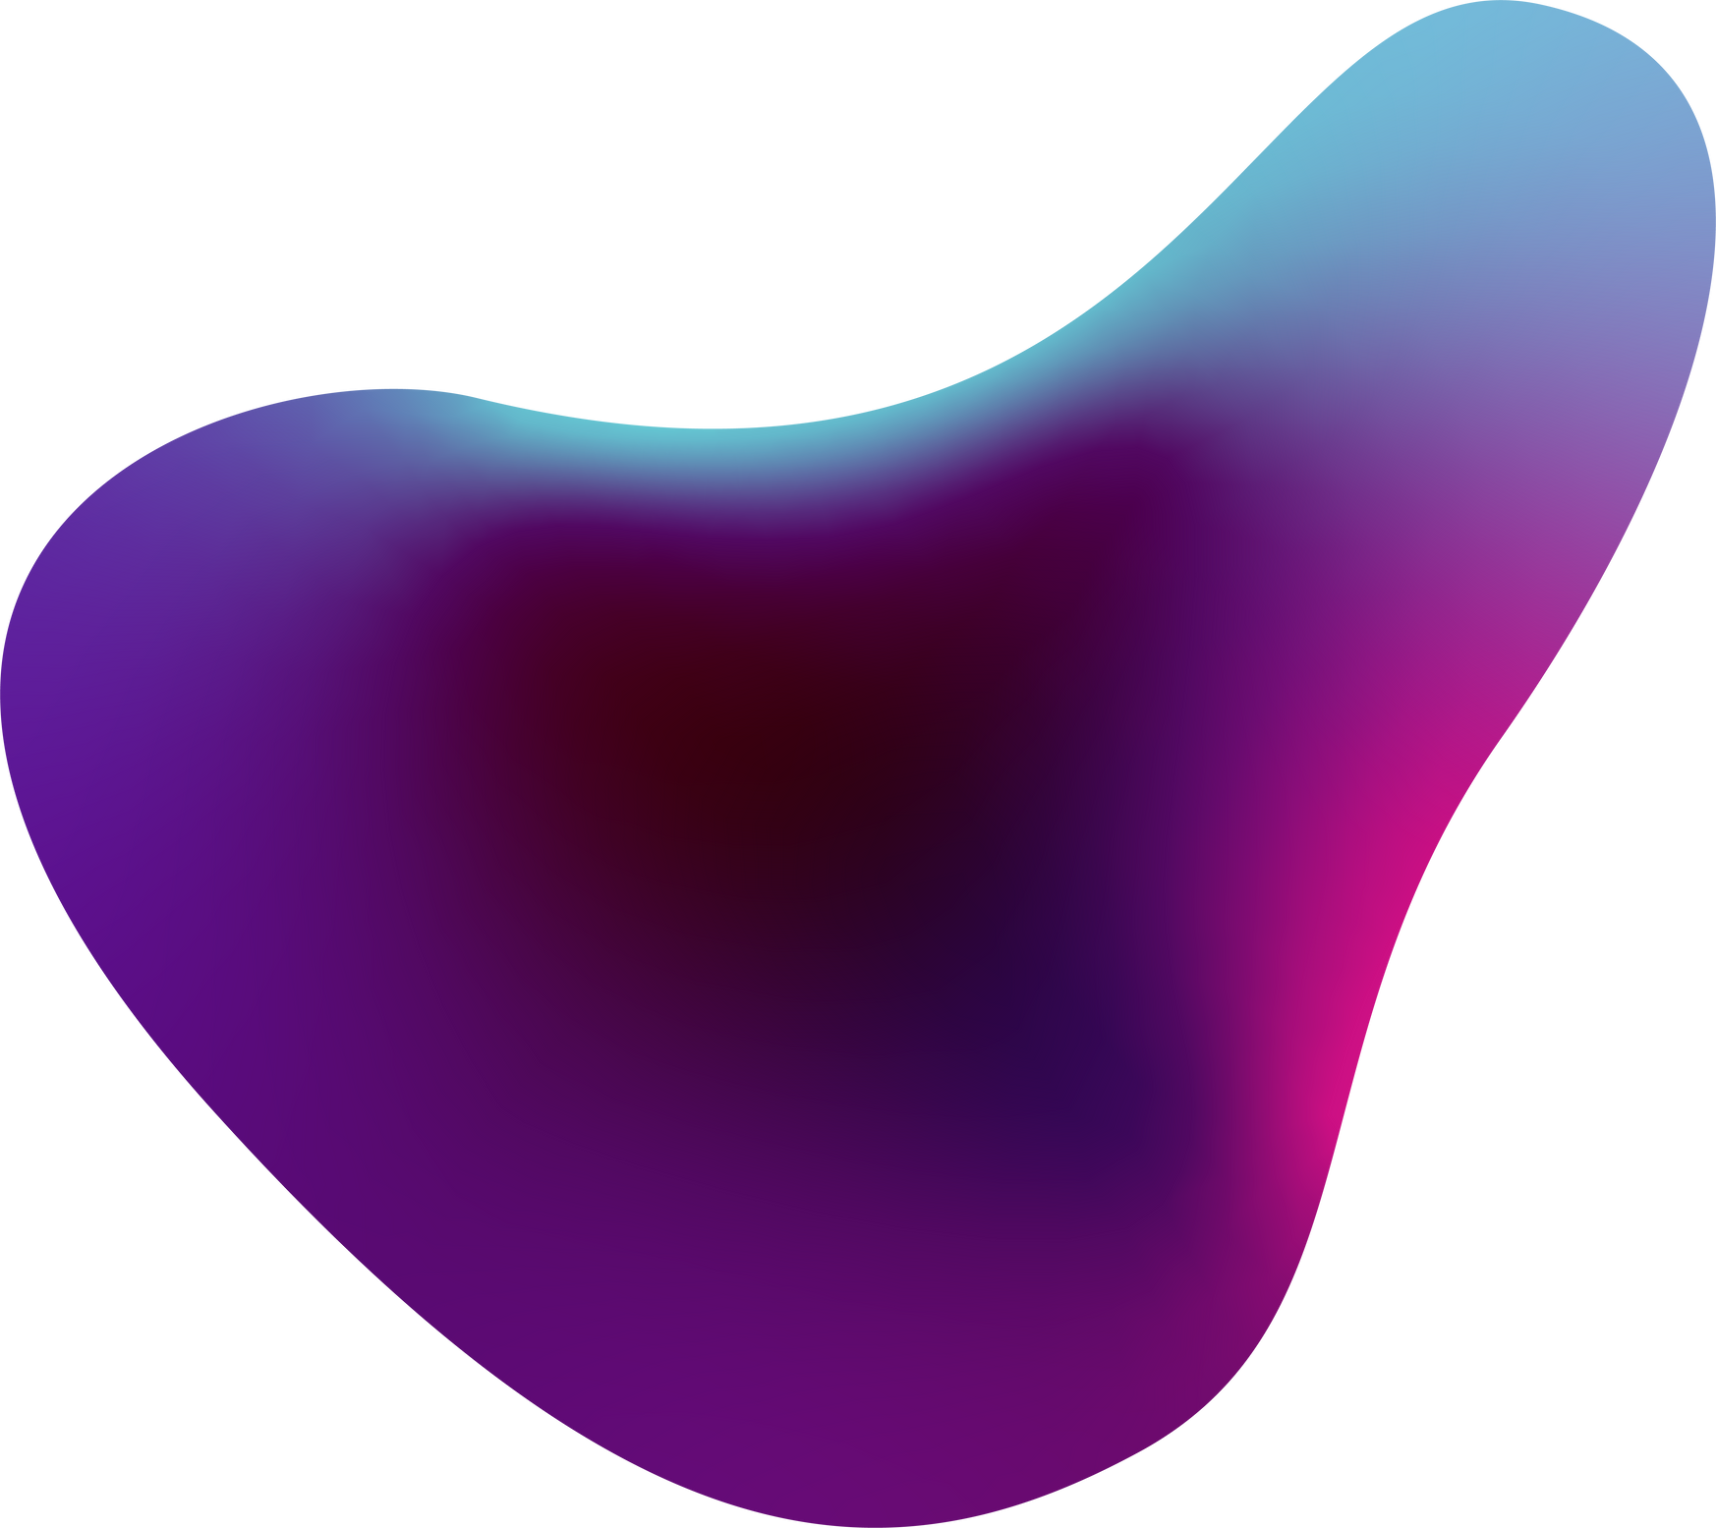


Healthcare Consultation Chatbot
Nishi Gandhi

Slide 2
Introduction​
Overview
Objectives
- The Healthcare Consultation Chatbot aims to assist users with healthcare-related inquiries by leveraging advanced AI techniques.​
- It integrates medical articles, research papers, and guidelines to provide accurate and timely responses.
- Deploy a fully functional chatbot application.​
- Explore and implement agent-based flows using LangChain.​
- Ensure security against adversarial attacks.​
- Fine-tune a pre-trained model on a small dataset.​
- Build a simple GPT model from scratch.​
- Implement advanced RAG methodologies.

Slide 3
The chatbot utilizes Retrieval-Augmented Generation (RAG) to fetch and provide relevant medical information.​
Use Case:
- Telemedicine Platforms: Enhance virtual consultations with instant access to medical literature.​
- Health Insurance Companies: Provide policyholders with accurate healthcare information and support.​
Description

Slide 4
Application Deployment​
Frontend
Backend
Database
User-friendly interface designed for easy interaction.​
Features include text input for inquiries, response display, and conversation history.
APIs for handling user queries, fetching data, and generating responses.​
Integration with medical databases and repositories.​
Stores conversation history to enable context-aware responses.​
Supports user data management and analytics.​

Slide 5
LangGraph and Agent-Based Flows

Slide 6

LangChain Tools
Utilize web scraping agents to collect and update medical information.​
Implement code execution agents for processing and analyzing data.​

Slide 7

Agent-Based Flows
Develop rule-based graphs to manage different types of user queries.​
Ensure comprehensive coverage of medical topics and use cases.​

Slide 8
Dataset
https://www.kaggle.com/datasets/jpmiller/layoutlm

Slide 9
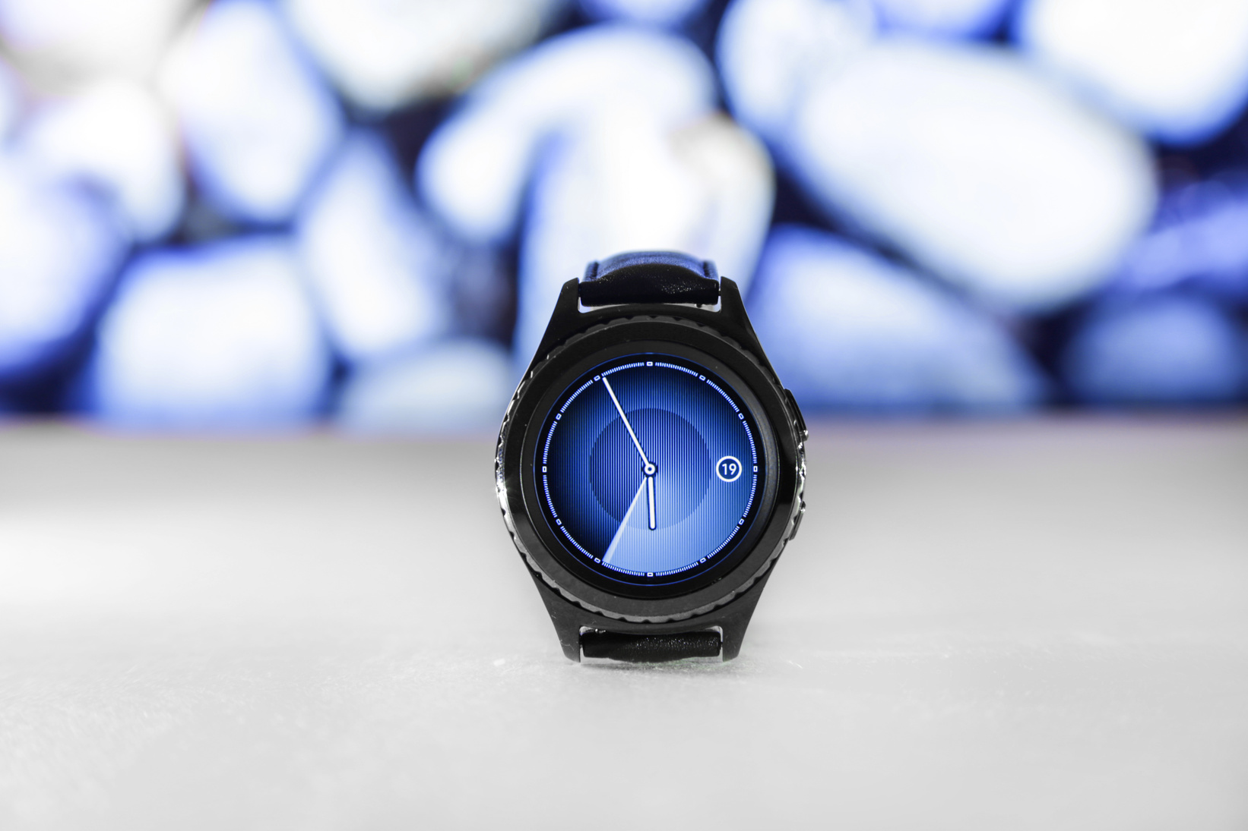

Challenges and Solutions​
Challenges
Solutions
Ensuring data privacy and security.​
Handling complex medical queries accurately.​
Maintaining up-to-date medical information.​
Implement robust security measures and data encryption.​
Fine-tune the model with diverse medical datasets.​
Use automated web scraping and data validation techniques.

Slide 10
Future Work​
Enhancements:​
- Incorporate voice interaction capabilities.​
- Expand the dataset with more diverse medical literature.​
- Integrate with electronic health record (EHR) systems.​
Scalability:​
- Discuss plans for scaling the application to handle more users.​
- Explore cloud-based solutions for improved performance and reliability.

Slide 11
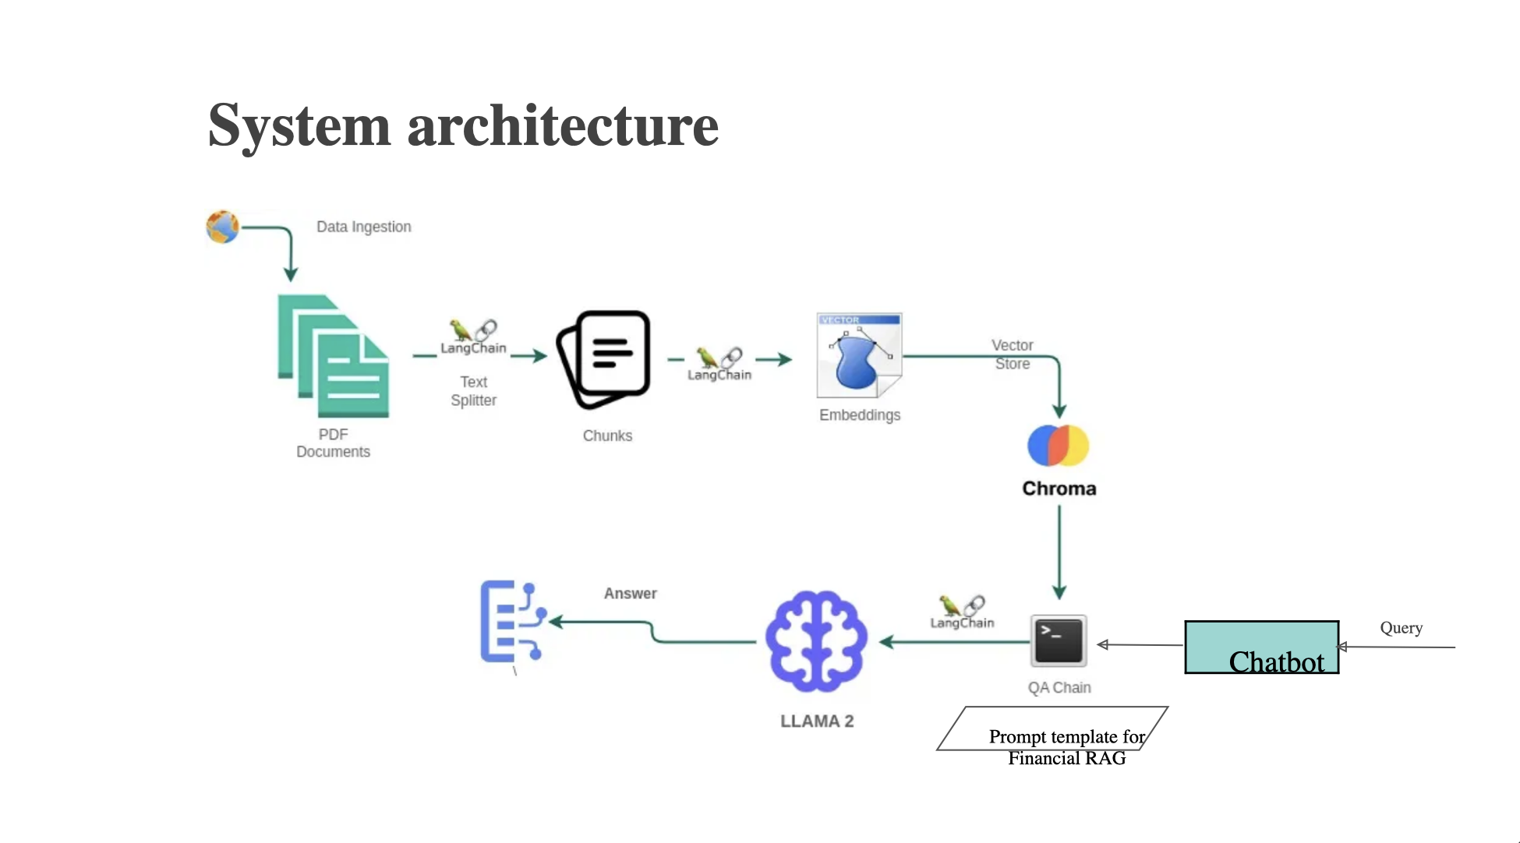

Slide 12

Thank You!

Slide 13
MedBot: Medical Consultation Chatbot by Liu et al. ​
A Novel Approach for Medical Assistance Using Trained Chatbot by Patel et al. ​
Combining Retrieval and Generative Models for Dialogue: A Tale of Two Task-Oriented Chatbots by Shikib Mehri et al. ​
Question Answering Using Web Data: Beyond the Short Answer by Xiang Ren et al.
​
References

